Slide 1

06. Python – Miscellaneous Topics - I

Slide 2
Topics
1
File Operations
2
Pickle
3
JSON
4
Config Parser
I
Problems
II
Assignments

Slide 3
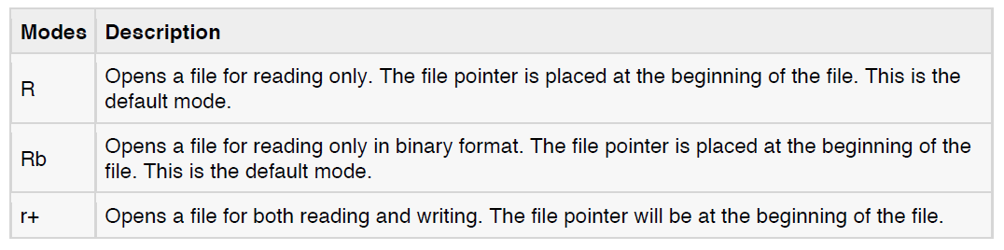
File Operations
Opening and Closing Files:
The open Function:
file object = open(file_name , access_mode, buffering)
with open(file_name, access_mode, buffering) as handle:
your code
access_mode:

Slide 4
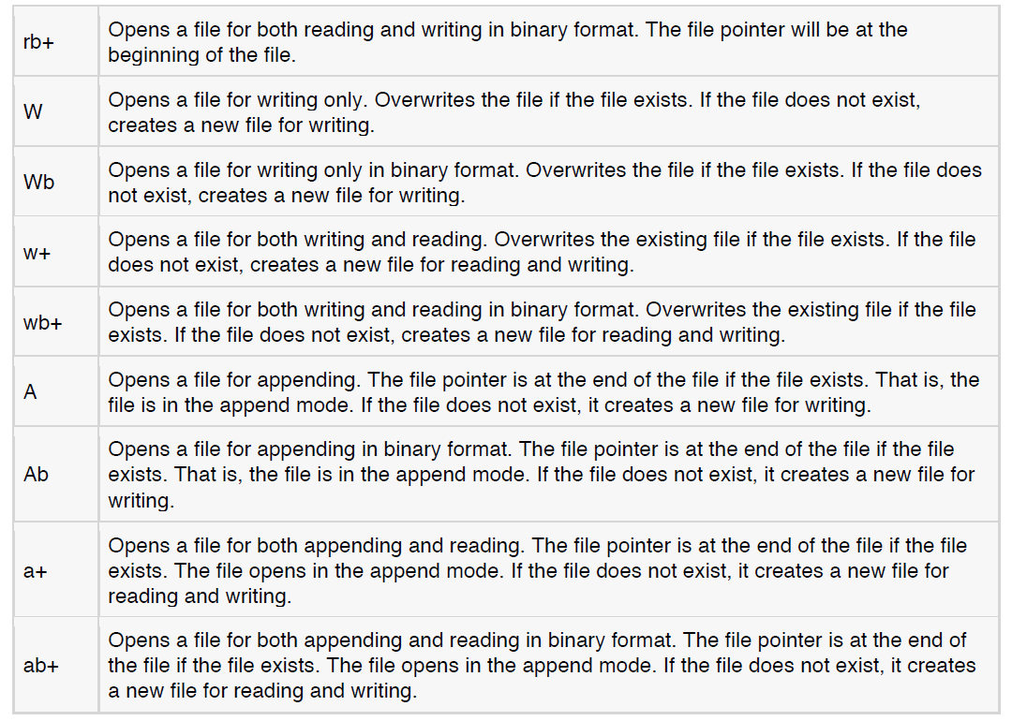
File Operations

Slide 5
File Operations
The close() Method:
fileObject.close()
Reading and Writing Files:
The write() Method:
fileObject.write(string)
The read() Method:
fileObject.read([count]

Slide 6
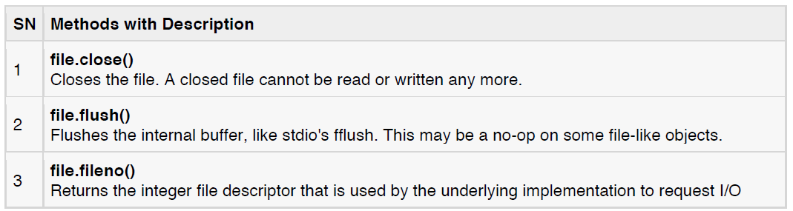
File Operations
File Object Methods

Slide 7
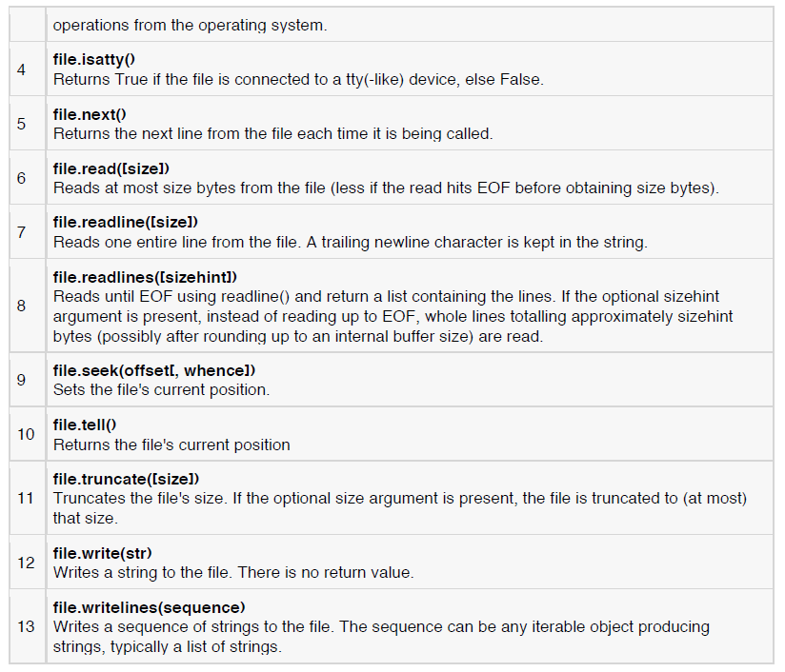
File Operations

Slide 8
Pickle
The pickle module implements a fundamental, but powerful algorithm for serializing and de-serializing a Python object structure.
“Pickling” is the process whereby a Python object hierarchy is converted into a byte stream
And “unpickling” is the reverse operation
There are currently 3 different protocols which can be used for pickling.
Protocol version 0 is the original ASCII protocol and is backwards compatible with earlier versions of Python.
Protocol version 1 is the old binary format which is also compatible with earlier versions of Python.
Protocol version 2 was introduced in Python 2.3. It provides much more efficient pickling of new-style classes.
Warning : Never unpickle data received from an untrusted or unauthenticated source.

Slide 9
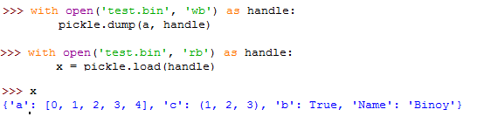
Pickle
pickle.load(file) / Unpickler(file).load()
pickle.dumps(obj[, protocol])
pickle.dump(obj, file[, protocol])/ Pickler(file, protocol).dump(obj)
pickle.loads(string)

Slide 10
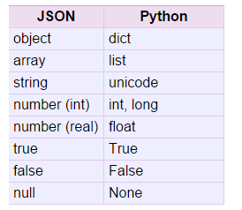
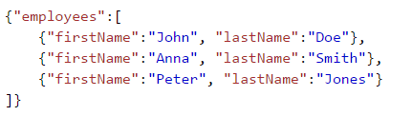
JSON(JavaScript Object Notation)
JSON stands for JavaScript Object Notation
JSON is a lightweight data-interchange format
JSON is language independent
JSON is "self-describing" and easy to understand

Slide 11
JSON
json.dump(obj, fp)
json.dumps(obj)
json.load(fp)
json.loads(s)

Slide 12
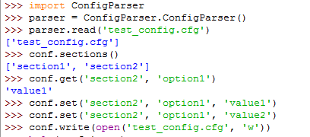
ConfigParser

Slide 13
Assignments
Write a program to copy the contents from “input.txt” to “output.txt” using file “read” and “write” operations.

Slide 14
Thank you
for your attention!

